Slide 1
Collecting Data
11.3b

Slide 2
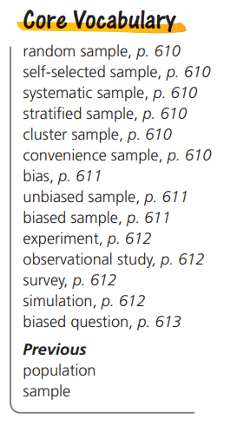
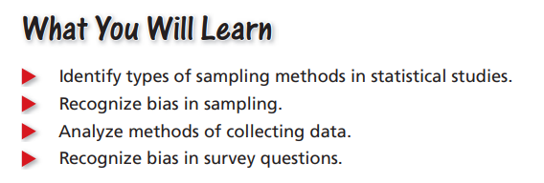

Slide 4
Identifying Methods of Data Collection Identify the method of data collection each situation describes.
A researcher records whether people at a gas station use hand sanitizer.
A landscaper fertilizes 20 lawns with a regular fertilizer mix and 20 lawns with a new organic fertilizer. The landscaper then compares the lawns after 10 weeks and determines which fertilizer is better
SOLUTION
The researcher is gathering data without controlling the individuals or applying a treatment. So, this situation is an observational study.
b. A treatment (organic fertilizer) is being applied to some of the individuals (lawns) in the study. So, this situation is an experiment.

Slide 5
On your own:
Identify the method of data collection the situation describes
Members of a student council at your school ask every eighth student who enters the cafeteria whether they like the snacks in the school’s vending machines.
A park ranger measures and records the heights of trees in a park as they grow.
A researcher uses a computer program to help determine how fast an influenza virus might spread within a city.
Solution:
Survey
b. Observational
c. Simulation

Slide 6
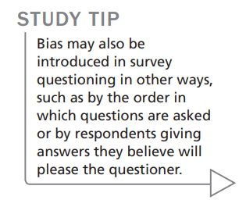
Recognizing Bias in Survey Questions
When designing a survey, it is important to word survey questions so they do not lead to biased results. Answers to poorly worded questions may not accurately reflect the opinions or actions of those being surveyed.
Questions that are flawed in a way that leads to inaccurate results are called biased questions. Avoid questions that:
• encourage a particular response
• are too sensitive to answer truthfully
• do not provide enough information
• address more than one issue to give an accurate opinion

Slide 7
Identify and Correct Bias in Survey Questioning
A dentist surveys his patients by asking, “Do you brush your teeth at least twice per day and floss every day?” Explain why the question may be biased or otherwise introduce bias into the survey. Then describe a way to correct the flaw.

Slide 8
On your own: Explain why the survey question below may be biased or otherwise introduce bias into the survey. Then describe a way to correct the flaw.
“Do you agree that our school cafeteria should switch to a healthier menu?”
SOLUTION
It encourages a yes response; Sample answer: Should the school cafeteria switch to a healthier menu?

Slide 9
Homework: page 615; Exercises 21 – 32, 34

